Slide 1
Asheville Urban Renewal
Group 4:
Xander Smead, Yicheng Wang, Daniel Rong, Zhaojie Yin, Anna Kafrune

Slide 2
Background on Urban Renewal
Took place from 60’s-90’s
East Riverside was the neighborhood most heavily affected by the urban renewal projects
This neighborhood housed more than 50% of the cities African American Residents
The city of Asheville used the power of eminent domain to uproot African American families and businesses, taking away homeownership, and affecting generational wealth

Slide 3
Background on Data
Most documents are official city files.
60 scanned pages from Block 53-Parcel 1, which covers 9 buildings in total (1 business and 17 families)
Rental agreements, establishment of rental charges, deeds, claims for relocation payments, descriptions of improvements property inspections, and photos
Scanned Map
Significance: Documentation that proves the relocation of a large number of Asheville citizens from their homes.

Slide 4
Background: what do we expect to do
Potential users: FR1 FR3
FR1 searches for an address/street name to zoom into his former house and see how much it cost.
FR1 wants to know if his property was bulldozed or fixed (partially identifiable).
FR1 wants to know how many days they took to receive the compensation and finally give up his house /
apartment.
FR1 wants to know the original purchasing price of their house, the fees collected by HACA and the final price
for their house. Maybe he also want to know the original offer and final price of his neighbor’s house.
FR1 wants to know whether he was the only person with a low offer from the appraiser If there were some
people in the same situation, what was the difference between the highest appraiser’s value and the final
value.
FR3 hears about this application and recalls the memory of her parents owning property around Asheville.
FR3 wants to know what happened to other neighbors, because she does not remember anybody there.
FR3 wants to see whether she her family got paid equitably by HACA.
FR3 wants to know whether there were any hidden records related to this transaction.

Slide 5
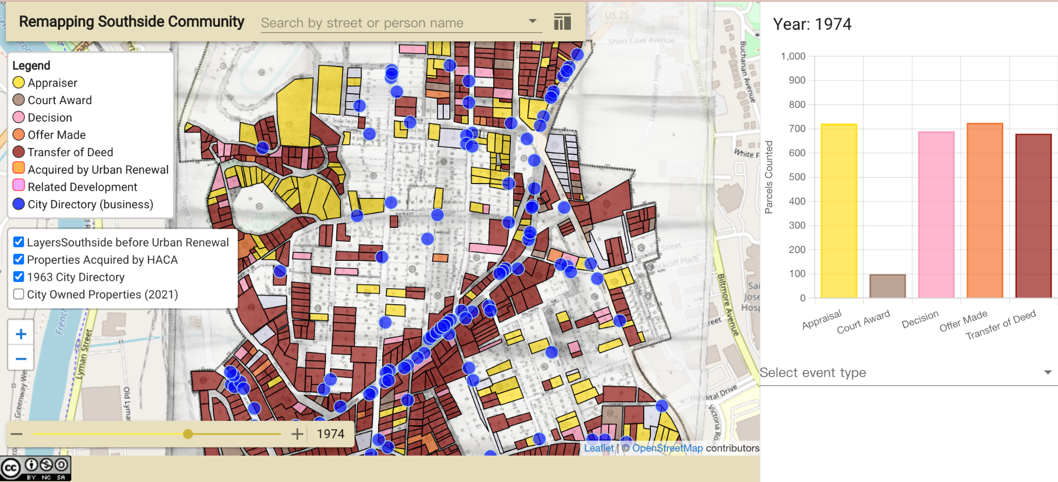
A quick overview of the remapping southside website

Slide 6
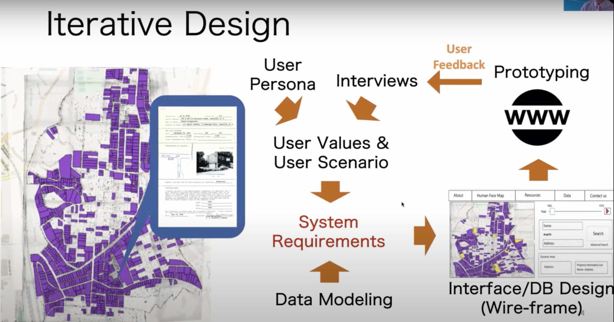
Notes:
Digital layer generation: paper map, scanning & adjust, geo-referencing, and geo tracing

Slide 7
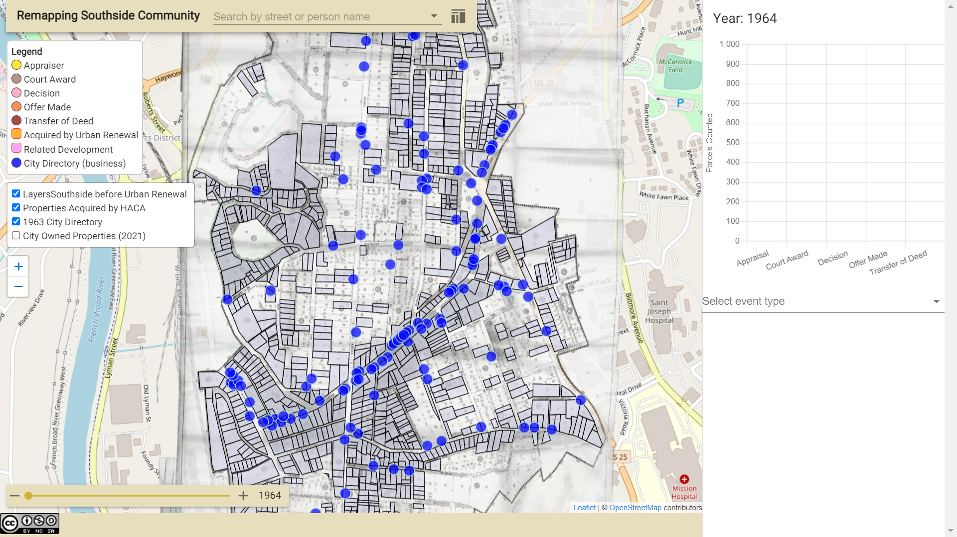
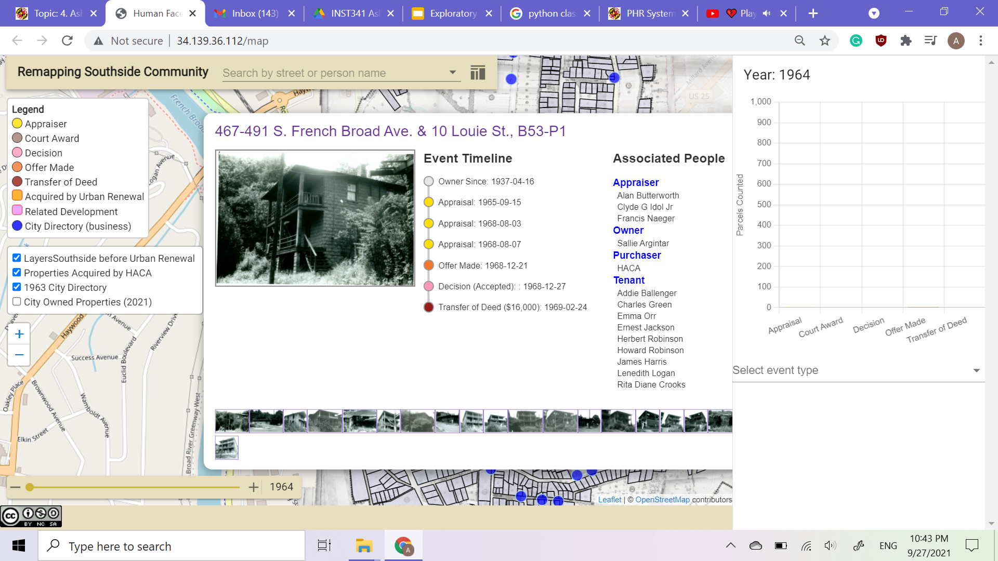
Analysis
Mostly text, but with an interactive map
Notes:
Mostly text, but with a map
The Acquisitions collection is made of 170 boxes with folders
There is an inventory of boxes and folders
Analog historical map turned digital through scanning, reconstruction, and photoshop
60-page file analysis - Block 53, Parcel 1

Slide 8
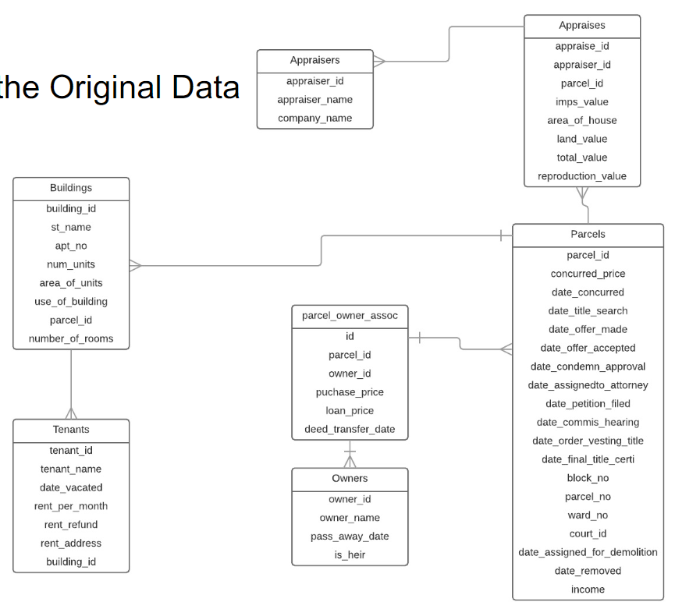
Analysis
Initial model
to event based model

Slide 9
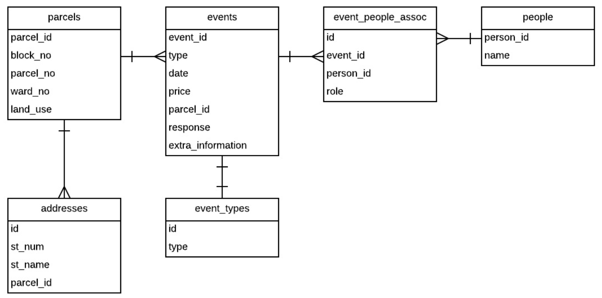

Slide 10
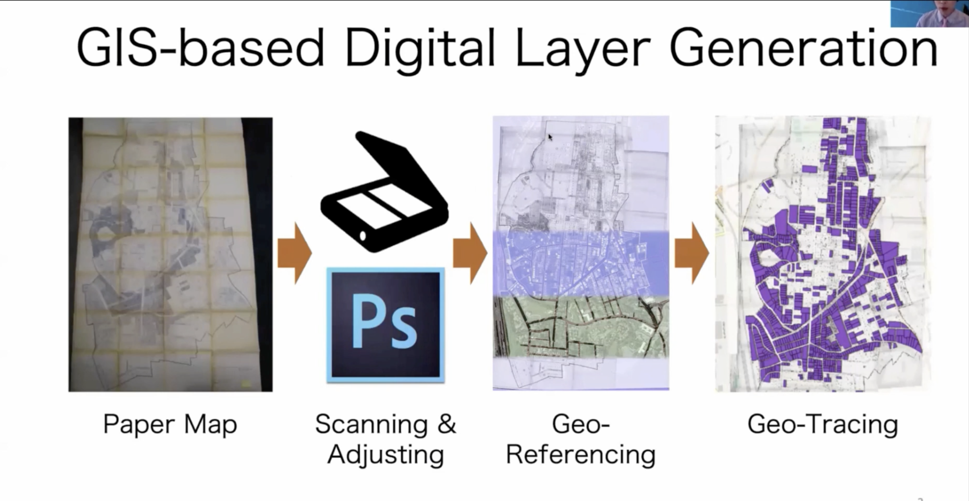
Analysis
Analog historical map turned digital through scanning, reconstruction, and photoshop
The Acquisitions collection is made of 170 boxes with folders
Block 53, Parcel 1

Slide 11
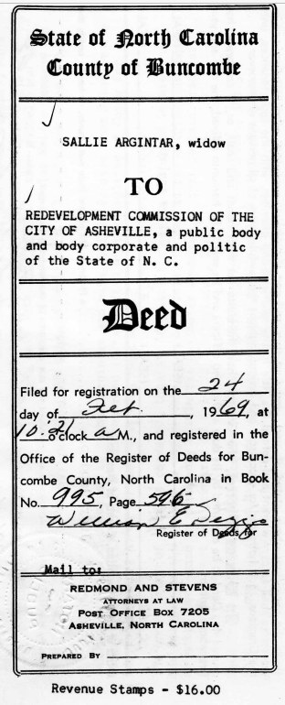
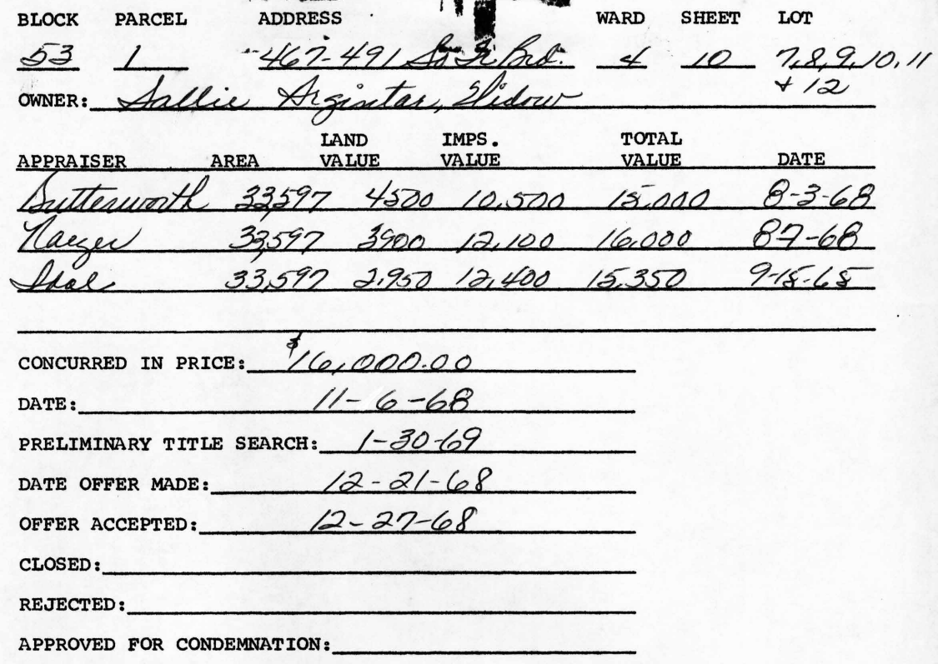
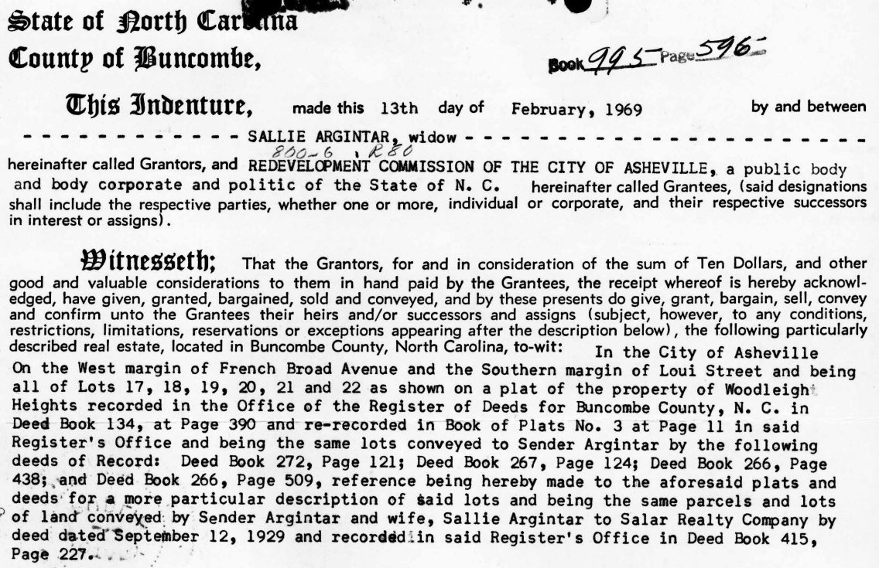
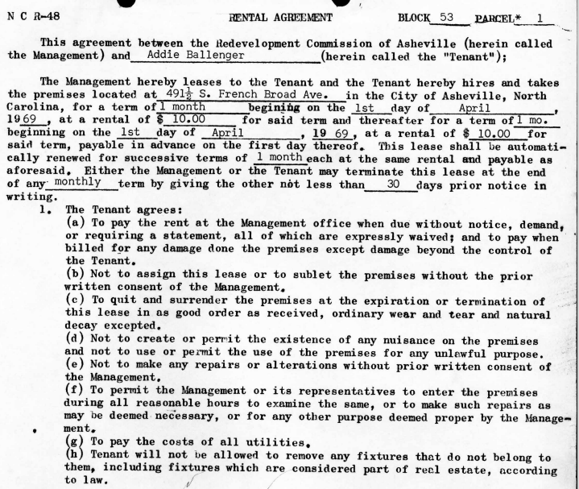
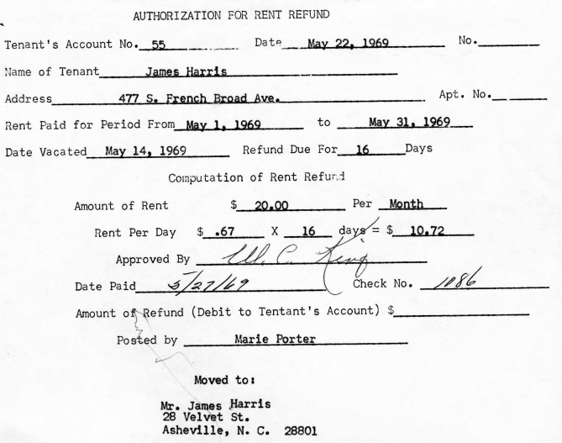
Summary of property history Deed of the property
Rent refund authorization Rental agreement
Notes:
Example images are from Block 53, Parcel 1
Summary of property history
Deed of the property (property sale acknowledgement and passing of rights agreement to hers/successors)
Rent refund authorization
Rental agreement
Rent payment receipt
Final certificate of title (passing the property to the Redevelopment Commission of the City of Asheville)
Details on the property purchase price and the cost involved in the purchase process
Claim for relocation payment (reimbursements for moving expenses and direct loss of property)
Preliminary certificate
Description of improvements
Reproduction value
Income value
Comparable value

Slide 12
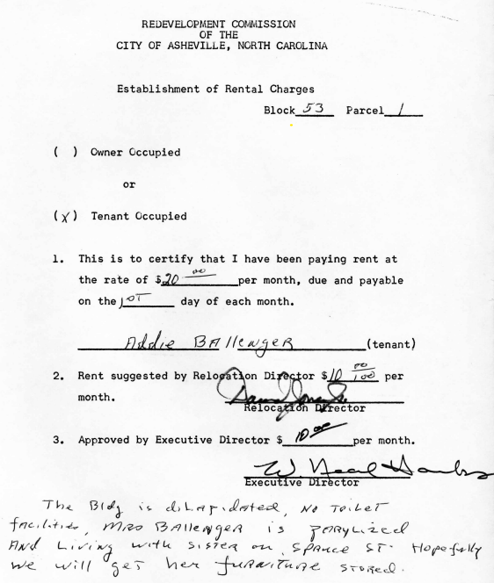
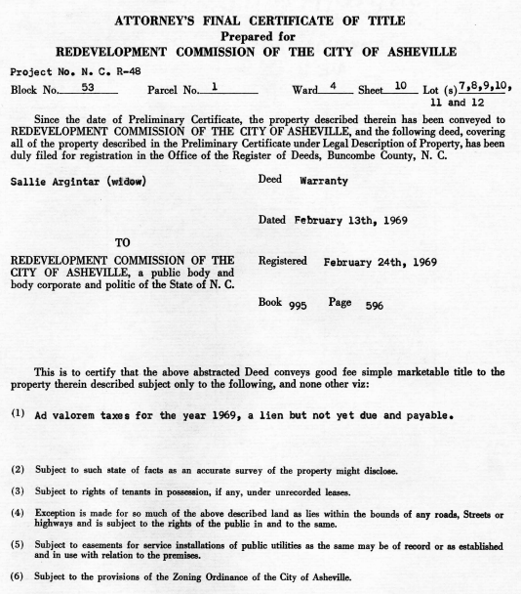
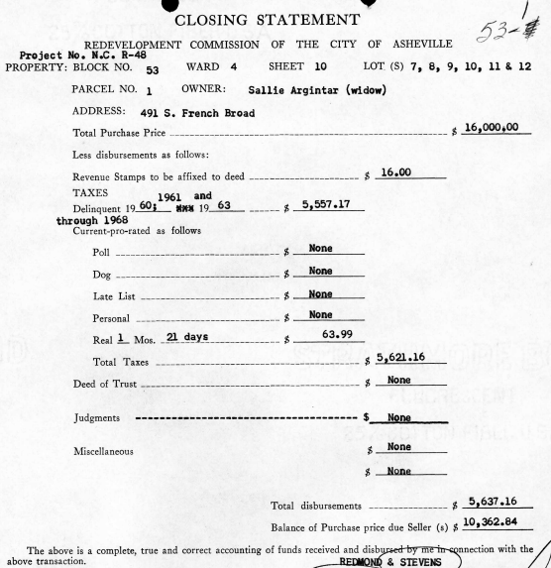
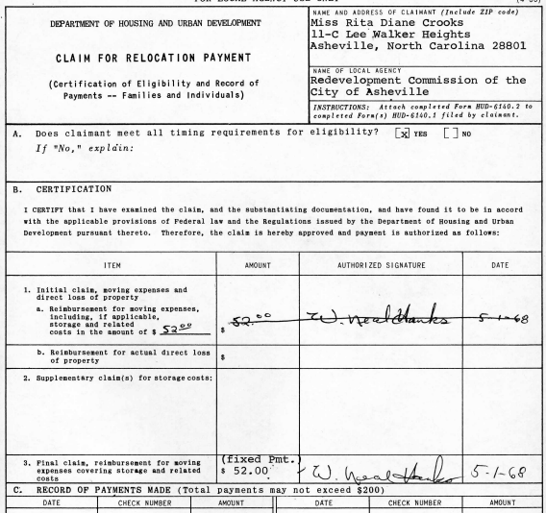
Rent payment receipt Final certificate
of title
Details on the property Claim for relocation
purchase price & cost payment
involved in the purchase

Slide 13
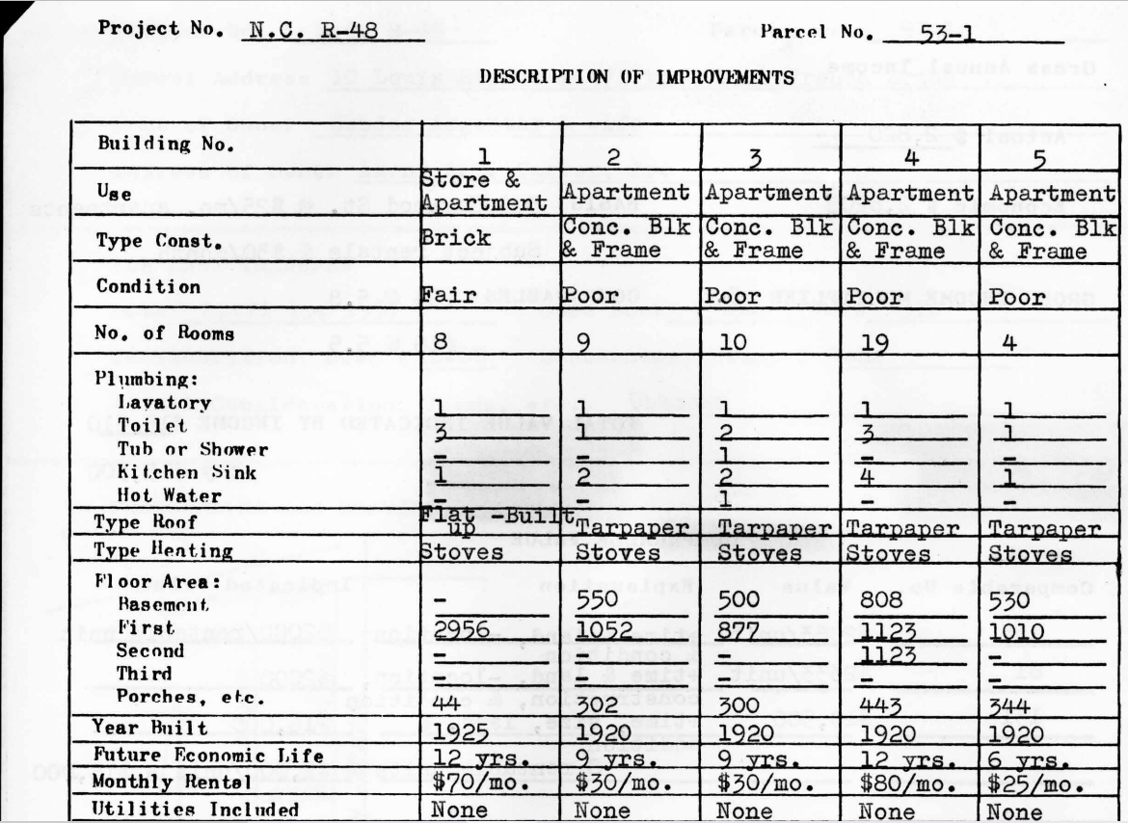
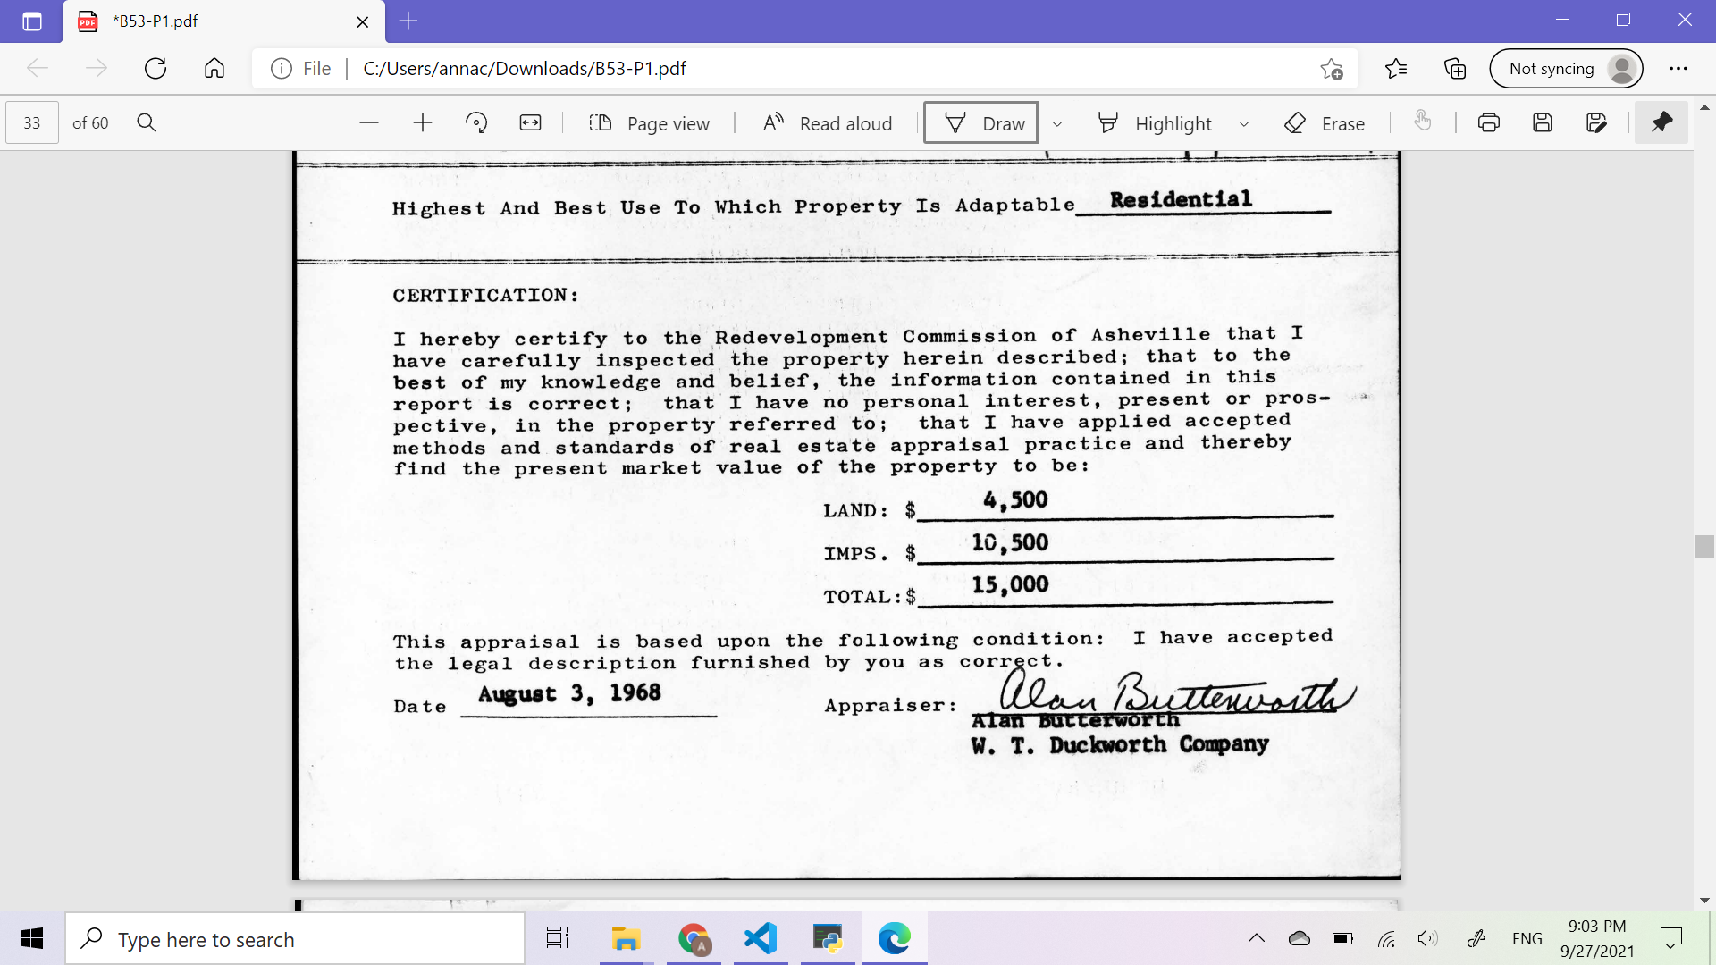
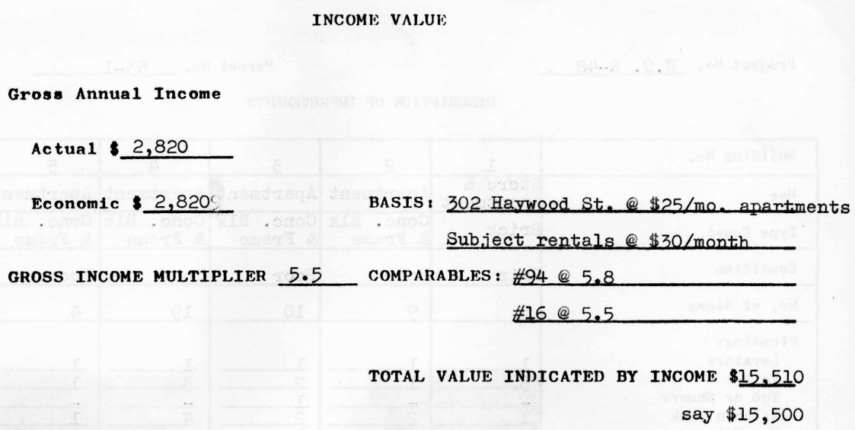
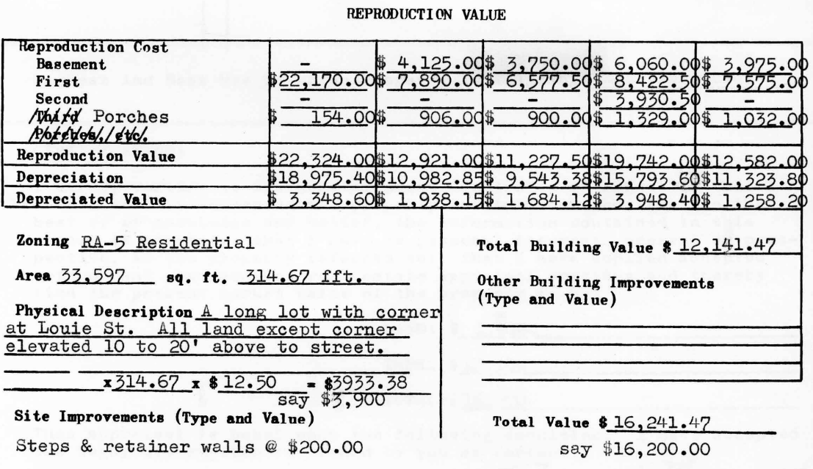
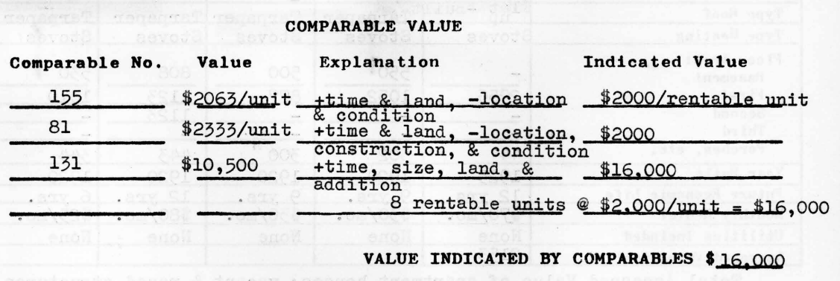
Preliminary certificate Description of improvements
Reproduction value Income value
Comparable value

Slide 14
Existing Digital Curation
-- Map visualization
Bar chart -- event count
Event Timeline -- timeline for each property’s event
Color
-- SQL database
Notes:
Two main information curation in this project -- Map visualization and SQL tables

Slide 15
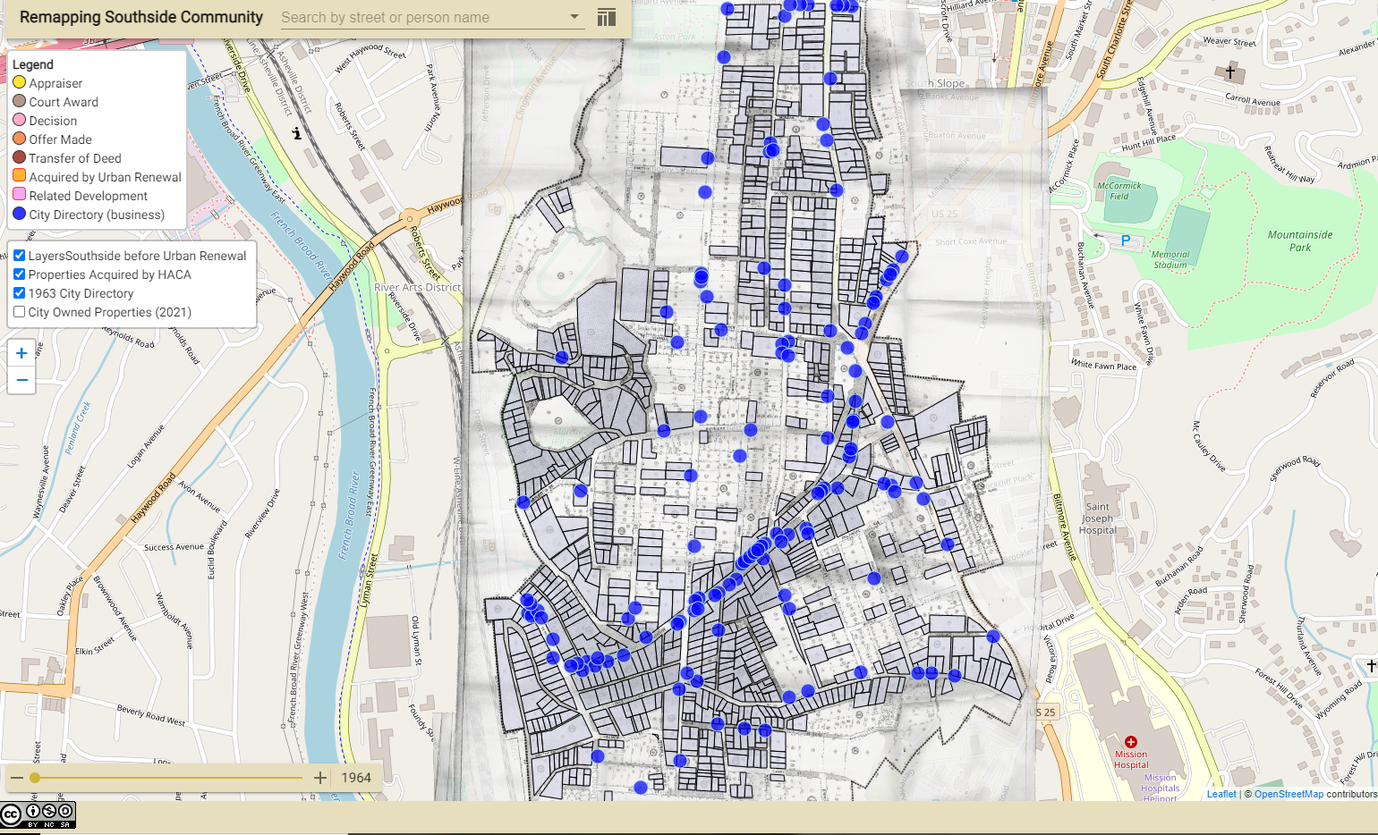
Map visualization -- Interactive Map
-
Notes:
Map Visualization -- display data as locations on an interactive map.In this interactive map, users can read detailed information about each property by clicking grids.

Slide 16
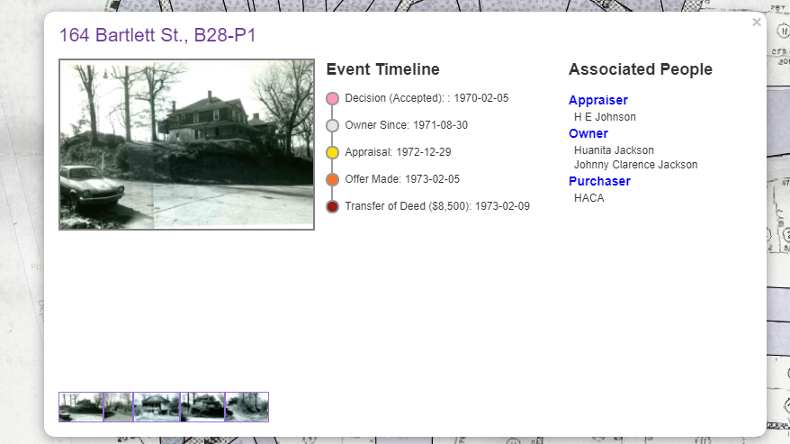
Map visualization -- Timeline
-
Notes:
Event Timeline: Specific data for each event (Decision Appraisal , offer ,transfer completion ) were given to present the process that each specific property went through in urban renewal and accompany with people associate with those events

Slide 17
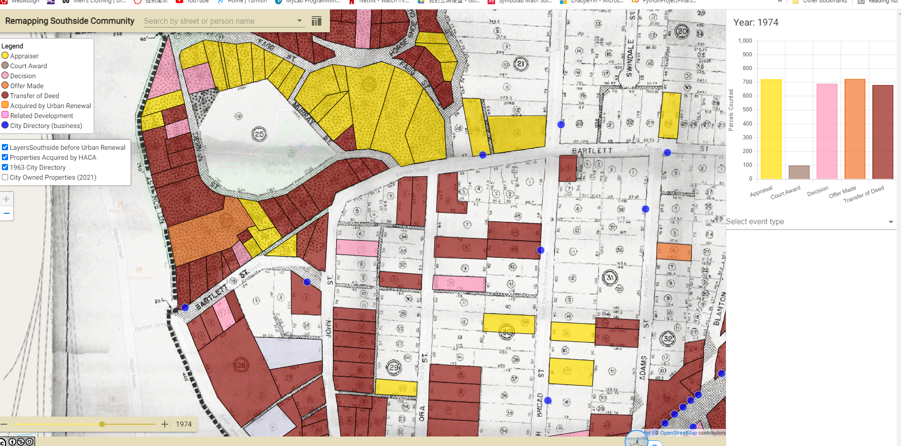
Map visualization -- Color
-
Notes:
Color -- Usually to represent geographic regions. For example, color is used to highlight the properties acquired by HACA in this map. Besides, it also represents each event( appraisal, court award decision, etc) for each year in bar chart
Bar chart -- visualize the record of counts for each event

Slide 18
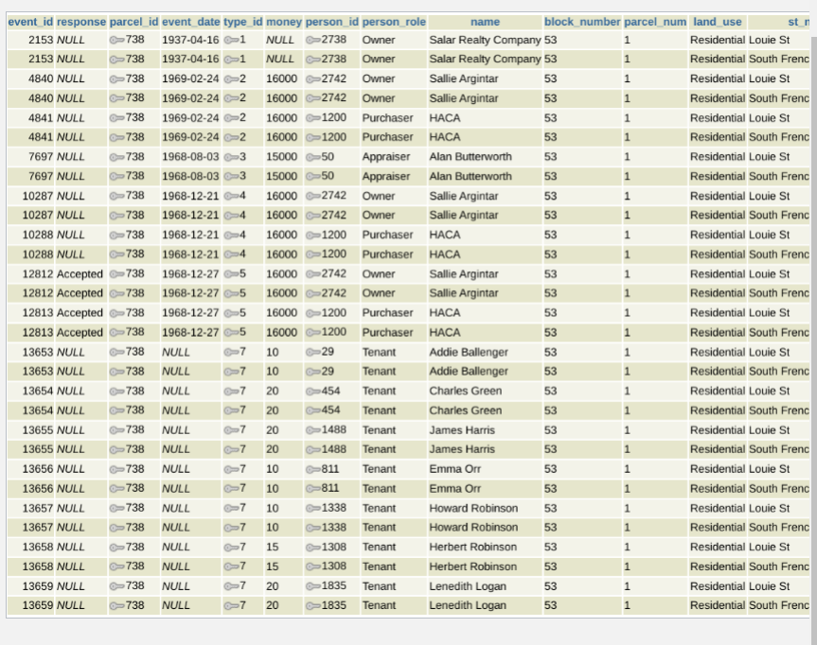
SQL Database -- Joined Table
-
Notes:
TABLES -- this data management process is completed by combining data by primary key for multiple tables to build connection for each data source. It is a good example of record original data sources into digital version and make operation

Slide 19
Future work
Explore economic trends
Further development of the database structure
Formation of a reparations commission
Notes:
Digital curation is more than just the archiving of data, but also utilizing it
Economic trends:
Can follow individuals building and track it throughout time and see how it’s property value/earnings have changed over time
further development of the database structure/diagram (ERD)
explanation of why we would have made the changes and perhaps a few examples of how the rows would look in their respective entities? Current implementation is inefficient due to needing multiple entries of the same thing?
Enables future work on exploring the impact of urban renewal
Reparations
Reparations acknowledge the government’s role in denying wealth-building opportunities to Black people.

